Slide 1
PDE 3802 Intelligent Sensing for Robotics Week 2b:OpenCV
Department of Design Engineering and Mathematics

Slide 2
Setup for the course
Download and Install Anaconda
Create a virtual environment (different files depending on your OS)
Open JupyterLab
Work with both notebooks and .py scripts with JupyterLab
https://www.anaconda.com/download/

Slide 3
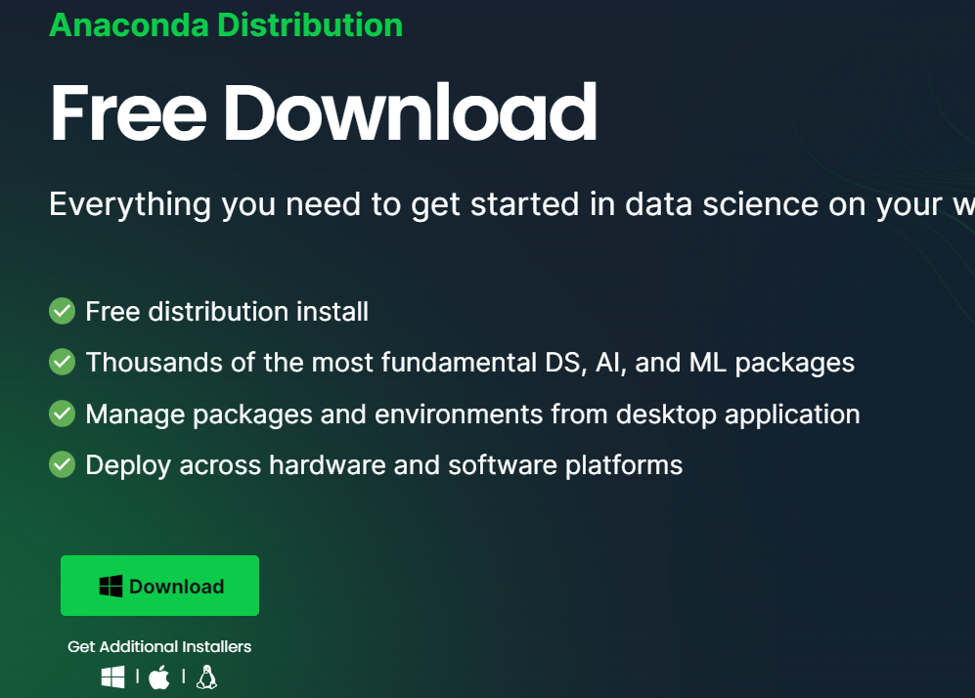
Choose your operating system

Slide 4
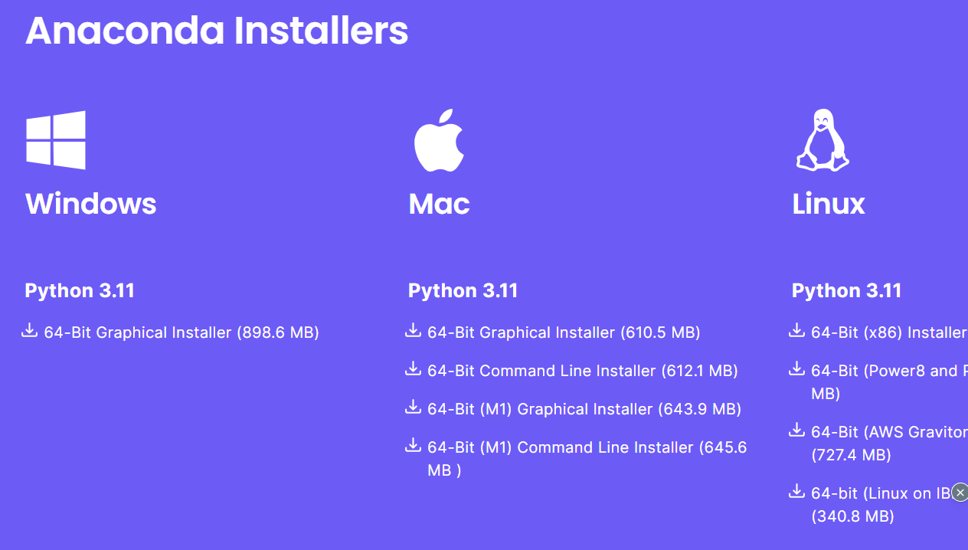
Choose you operating system

Slide 5
Remove any spaces in the username
Add Anaconda to my Path environment variable
After installation we now need to download the libraries used for this course.
The installation has installed the Anaconda Prompt command line tool.
We’ll be using it for these next step
Create a new environment
Install JupyterLab and Jupyter Notebook in this environment

Slide 6
Numpy Arrays
Open 00-NumPy-Arrays
Run the line by shift-enter
Arrays
Numpy:
List
Np.array
Np.arange
Np.zeros, np.ones
Operations
Np.random.randint
We can use the following on numpy arrays
Max, min, mean, argmin, argmax, reshape
Np.arange.reshape

Slide 7
Images and Numpy
Open Week 2b_0-Images-and-NumPy.ipynb
from PIL import Image
import matplotlib.pyplot as plt
Image.open
np.asarray(pic)
pic_arr.shape: (1300,1950,3) shape
plt.imshow(pic_arr)
pic_red = pic_arr.copy(), pic_red[:, :, 1] = 0 , pic_red[:, :, 2] = 0

Slide 8
OpenCV
Open Anaconda Prompt
Type (or paste):
conda install opencv
pip install opencv-python
This should install OpenCV 4 (.11 latest stable version)

Slide 9
Some resources
On-line Computer Vision Compendium (University of Edinburgh):
http://homepages.inf.ed.ac.uk/rbf/CVonline/
Comprehensive list of computer vision methods:
https://sites.google.com/site/cvonlinewiki/home/generic-computer-vision-methods
OpenCV tutorials:
https://docs.opencv.org/4.5.0/d9/df8/tutorial_root.html
Image processing in OpenCV (but not only):
https://docs.opencv.org/4.5.0/d2/d96/tutorial_py_table_of_contents_imgproc.html
In OpenCV, make sure you are looking at the Python code, not C++

Slide 10
Introduction
In this section we will begin building an understanding of how to use the OpenCV library.
Specifically how to open images and draw on them.
Later on we will expand on this.

Slide 11
OpenCV Basics
OpenCV (Open Source Computer Vision) is a library of programming functions mainly aimed at real-time computer vision.
Created by Intel in 1999, it is written in C++ (we will be using the Python bindings)
It contains many popular algorithms for computer vision, including object detection and tracking algorithms built-in.
We’ll start with the basics and slowly work our way up!

Slide 12
OpenCV Basics
Section Goals:
Be able to open image files with OpenCV in both a notebook and a python script.
Draw simple geometries on images.
Directly interact with an image through callbacks.
Open an image, click on it and the draw an object

Slide 13
Opening Image Files on Notebook
Open Week 2b_1-Opening-Image-Files-in-a-Notebook.ipynb
How to open image files in a Notebook
import numpy as np
import cv2
import matplotlib.pyplot as plt
img = cv2.imread(«path»)
plt.imshow(img_bgr)
img_rgb = cv2.cvtColor(img, cv2.COLOR_BGR2RGB)
img_gray = cv2.imread('puppy.jpg',cv2.IMREAD_GRAYSCALE)
plt.imshow(img_gray,cmap='gray’)
img_rgb.shape
img =cv2.resize(img_rgb,(1300,275))
new_img =cv2.resize(img_rgb,(0,0),img,w_ratio,h_ratio)
new_img = cv2.flip(new_img,0)
new_img = cv2.flip(new_img,-1)
cv2.imwrite('my_new_picture.jpg',new_img)

Slide 14
Opening Image Files
Week 2b_2-Opening-Images-with-OpenCV.ipynb
Open CV Python Script
In this part we will use OpenCV to display images in their own separate window outside of Jupyter.
For more complex video and image analysis, we’ll need to display outside of Jupyter.
While we often will just use plt.imshow to display images inside of a notebook, sometimes we want to use OpenCV on its own to display images in their own window.
Often Jupyter (being browser based) interferes with closing the window.

Slide 15
OpenCV Basics
Many times JupyterLab can display a new window with no issues, but the kernel crashes when the OpenCV window is closed.
To fix this potential issue, simply restart the kernel.
These issues appear more on MacOS and Linux than Windows.
If you get the kernel error often, simply run the code as a separate Python script.
Let’s show how to open and display images directly with OpenCV both in the notebook and as a script!

Slide 16
OpenCV Basics
Open Week 2b-OpenImage.py
Let’s now see how to open files using OpenCV and a normal Python .py script.
I will use VsCode
You can’t resize the image.
import cv2
img = cv2.imread('puppy.jpg',cv2.IMREAD_GRAYSCALE)
while True:
# Show the image with OpenCV
cv2.imshow('window_name',img)
# Wait for something on keyboard to be pressed to close window.
#if we've waited at least one 1msec AND we've pressed the escape key (27)
if cv2.waitKey(1) & 0xFF==27:
break
cv2.destroyAllWindows()
# cv2.waitKey()

Slide 17
Drawing on Images
Open Week 2b_3-Drawing-on-Images.ipynb
blank_img = np.zeros(shape=(512,512,3),dtype=np.int16)
cv2.rectangle(blank_img,pt1=(384,10),pt2=(500,150),color=(255,255,0),thickness=5) #this is inplace!!
cv2.rectangle(blank_img,pt1=(200,200),pt2=(300,300),color=(0,0,255),thickness=5)
cv2.circle(img=blank_img, center=(100,100), radius=50, color=(255,0,0), thickness=5)
cv2.circle(img=blank_img, center=(400,400), radius=50, color=(255,0,0), thickness=-1)
cv2.line(blank_img,pt1=(0,0),pt2=(511,511),color=(102, 255, 255),thickness=5)
font = cv2.FONT_HERSHEY_SIMPLEX
cv2.putText(blank_img,text='Hello',org=(10,500), fontFace=font,fontScale= 4,color=(255,255,255),thickness=2,lineType=cv2.LINE_AA)

Slide 18
PDE 3802 Week 2b Image Processing Tolga Girici

Slide 19
Introduction
Goals
Learn various image processing operations.
Perform image operations such as Smoothing, Blurring, Morphological Operations.
Grab properties such as color spaces and histograms.

Slide 20
Image analysis – Understand an image
Fundamental steps in image analysis:
Acquisition: to acquire a digital image
Preprocessing: to improve the image in ways that increase the chances for success of the other processes.
Segmentation: to partition an input image into its constituent parts or objects.
Representation: to convert the input data to a form suitable for computer processing.
Description: to extract features that result in some quantitative information of interest or features that are basic for differentiating one class of objects from another.
Recognition: to assign a label to an object based on the information provided by its descriptors.
Interpretation: to assign meaning to an ensemble of recognized objects.

Slide 21
Image processing (pixel manipulation)
Fundamental tasks in image processing: (not necessarily sequential!)
Conversion: convert the image to the format most suitable for the processing goals (resolution, channels, colour space, …)
Geometric transformations: adjust the image spatial properties (crop, resize, rescale, rotate, …)
Smoothing/sharpening: apply filters to reduce the image noise or enhance features and contrasts, …
Thresholding: convert the image into binary format to separate relevant features from background
Morphological transformations: clean-up binary image by eliminating false positive and false negative pixels
Gradients: fine edges, corners and other salient features

Slide 22
Color Spaces
We usually work with RGB color spaces,
in RGB coding, colors are modeled as a combination of Red, Green, and Blue.
In the 1970s HSL (hue, saturation, lightness) and HSV (hue, saturation, value) were developed as alternative color models.
HSL and HSV are more closely aligned with the way human vision actually perceives color.
While in the course we will deal almost exclusively with RGB images, its a good idea to understand how to convert to HSL and HSV colorspaces.

Slide 23
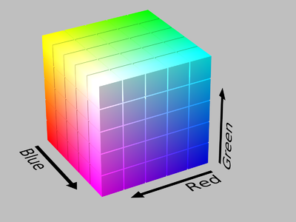
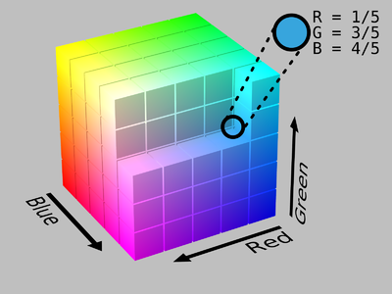
Color Spaces
RGB Model Representation of Colors
0 to 255 for Red Green and Blue

Slide 24
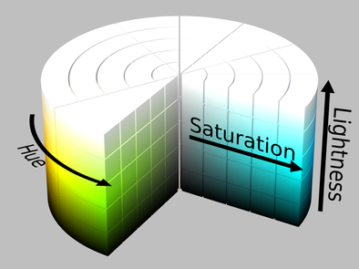
Color Spaces
HSL Cylinder Model
Changing colors all around the cylinder (hue)
Saturation: how much of that hue exists
Lightness: How light is the color
White is at the top

Slide 25
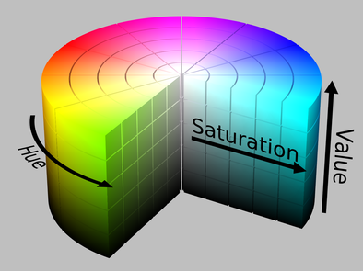
Color Spaces
HSV Cylinder Model
Similar to HSL (Hue and saturation)
Instead of lightness , there is value.
White is at the center

Slide 26
Color Spaces
This lecture will be a quick review on using the cvtColor function to change colorspaces.
We won’t have to deal with HSL or HSV based color images in the rest of the course.
Open Week15_5-Color-Mappings notebook.

Slide 27
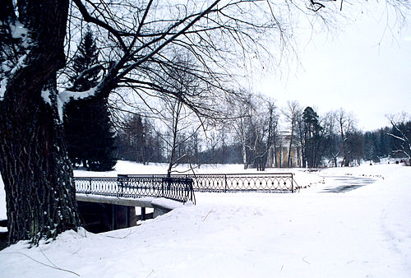
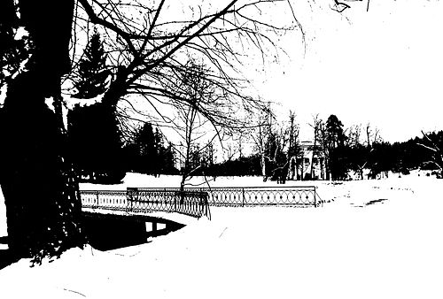
Image Thresholding
In some CV Applications it is often necessary to convert color images to grayscale, since only edges and shapes end up being important.
Similarly, some applications only require a binary image showing general shapes
Thresholding is fundamentally a very simple method of segmenting an image into different parts.
Thresholding will convert an image to consist of only two values, white (255) or black (0).

Slide 28
Image Thresholding
Open W15_6-Image-Thresholding notebook
cv2.threshold(image, threshold, maxvalue, option)
cv2.threshold(img,127, 255,cv2.THRESH_BINARY_INV)
cv2.threshold(img,127,255,cv2.THRESH_TRUNC)
Documentation
https://docs.opencv.org/3.4/db/d8e/tutorial_threshold.html
Crossword puzzle (there are gray places)
Make anywhere with ink , black, and the rest, white
https://stackoverflow.com/questions/28763419/adaptive-threshold-parameters-confusion
https://docs.opencv.org/4.x/d7/d4d/tutorial_py_thresholding.html

Slide 29
Image Blurring
A common operation for image processing is blurring or smoothing an image.
Smoothing an image can help get rid of noise, or help an application focus on general details.
There are many methods of blurring and smoothing.
Often blurring or smoothing is combined with edge detection.
Edge detection algorithms detect too many edges when shown a high resolution image without any blurring.

Slide 30
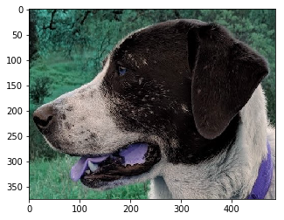
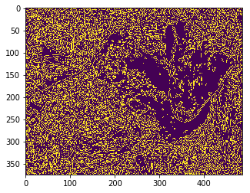
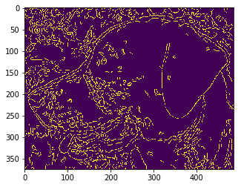
Often blurring or smoothing is combined with edge detection.
Edge detection may be very noisy (middle figure)
Edge detection can be done with blurring

Slide 31
Image Blurring
Methods we’ll be exploring
Gamma Correction
Gamma correction can be applied to an image to make it appear brighter or darker depending on the Gamma value chosen.
Methods we’ll be exploring
Kernel Based Filters
Kernels can be applied over an image to produce a variety of effects.
The best way to explain this is through an interactive visualization.
Go to: http://setosa.io/ev/image-kernels/
A Kernel is a matrix
https://docs.opencv.org/4.x/d4/d13/tutorial_py_filtering.html

Slide 32
Image Blurring
Open W2b_-Blurring-and-Smoothing notebook
Gamma correction
https://docs.opencv.org/3.4/d3/dc1/tutorial_basic_linear_transform.html
np.power(img, gamma)
Image gets brighter as gamma is decreased
Kernel methods
cv2.filter2D(img,-1,kernel)
https://stackoverflow.com/questions/43392956/explanation-for-ddepth-parameter-in-cv2-filter2d-opencv
cv2.blur(img,ksize=(5,5)) default blurring Kernel
cv2.medianBlur(img,5) Median Blur (removes noise)
cv2.GaussianBlur(img,(5,5),10) Gaussian Blur
https://en.wikipedia.org/wiki/Gaussian_blur
https://www.tutorialspoint.com/dip/concept_of_blurring.htm

